Slide 1

Balance Sheet - Class

Slide 2

BAP: Upcoming Events
Date | Time | Event | Room
9/9 | 5:45-7:45 | Meet the Firms | UMC
9/11 | 6:30-7:30 | KPMG & Deloitte | KOBL 100
←
BAP Application

Slide 3





















Meet the Firms
When: 9/9 @ 5:45-7:45pm
Where: UMC - Glenn Miller Ballroom

Slide 4

Key Points from the Video
The balance sheet reports assets, liabilities, and equity at a point in time
Assets and liabilities are organized by liquidity
Not all future benefits and costs are recognized under the accounting rules

Slide 5
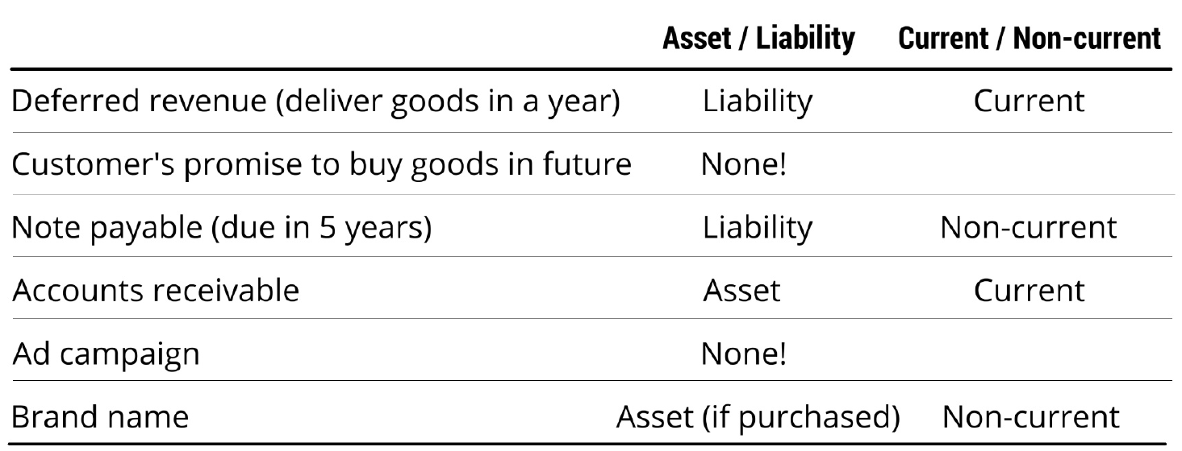
Asset or Liability? Current or Non?

Slide 6
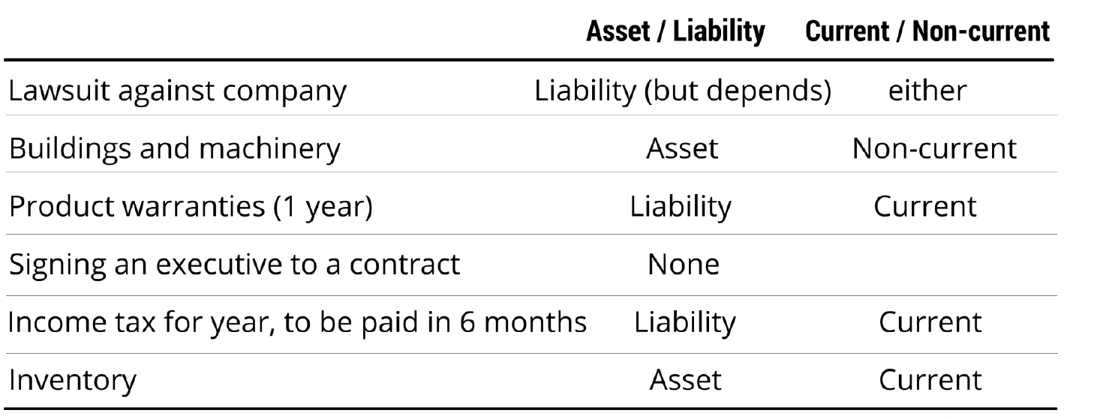
Asset or Liability? Current or Non?

Slide 7
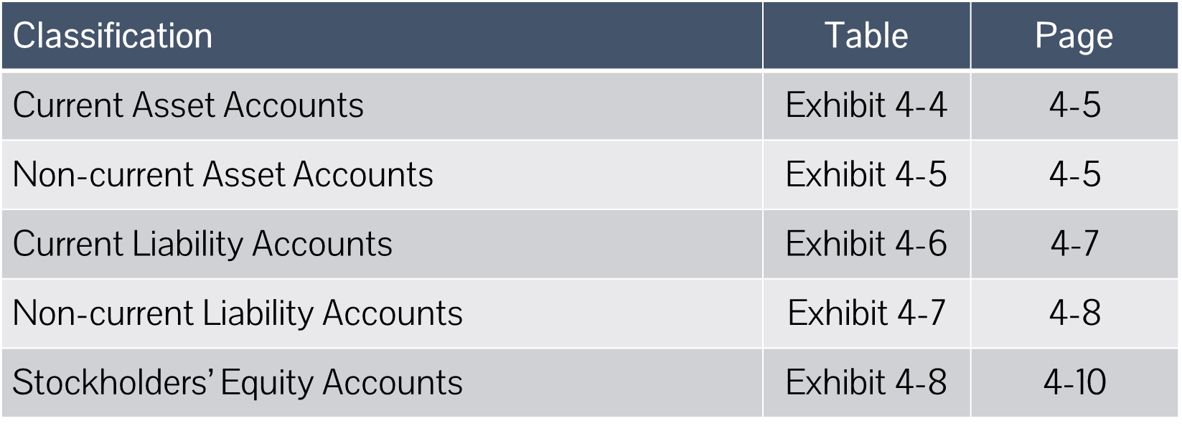
Useful Textbook References

Slide 8
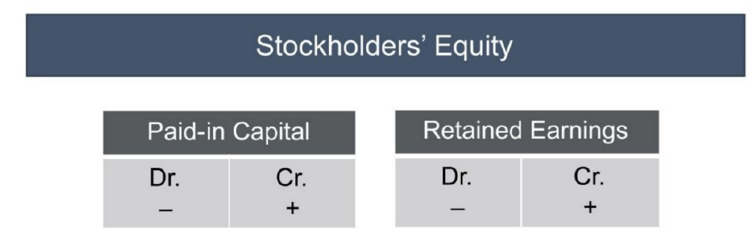
Shareholders’ Equity​
Residual interest in the firm (assets minus liabilities)
Other accounts:
Accumulated Other Comprehensive Income (AOCI)
Treasury Stock (Contra Equity)
Noncontrolling Interest
Notes:
Valuation​
-artifact of acctg, NOT market value​
-driven by the assets and liabilities on the balance sheet ​
-REMEMBER: ​
*many we don’t record​
*those that we do record may not be held at FV​
​
So, equity does not equate to market value or price!​

Slide 9
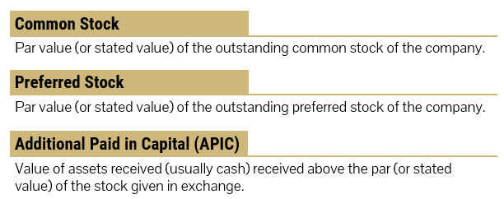
Paid-in or Contributed Capital
Cash from owners or investors:​
Notes:
What does this mean for you??​
---if you want to know what owners have contributed, add par and APIC together.​
​
I say common stock here. Book says capital stock. It’s the same thing. ​
​
Par is relic. An arbitrary number. Sometimes it comes from the companies charter. Sometimes it’s a requirement of the state where the company was incorporated.

Slide 10
Accounting for contributed capital
A company issues 100 shares common stock and receives $300 cash from investors. The stock has no par value listed.
Cash (B-A) 300
Common Stock (B-E) 300

Slide 11
What is Par Value?
Nominal value per share set by firm’s articles of incorporation
Legal relic – unrelated to market value
Usually very low (a penny or less); can be zero (or no par value)
Most important: It is the amount recorded to Common Stock

Slide 12
Accounting for contributed capital
A company issues 100 shares of $1 par value common stock and receives $300 cash from investors.
Cash (B-A) 300
Common Stock (B-E) 100
Additional Paid in Capital (B-E) 200
C/S: Recognized at Par Value
“APIC”

Slide 13
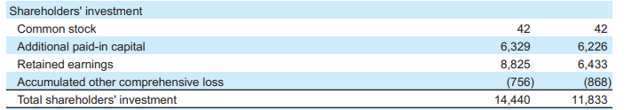

Shareholders’ Equity – Target 2020
What amount had been raised from common stock by Jan 30 2021?

Slide 14
Shareholders’ Equity – Target 2020
What amount had been raised from common stock by Jan 30 2021?
$6,371

Slide 15
Retained Earnings
Accumulated net earnings less payouts over life of the firm​
Increased by profits​
Reduced by losses​
Reduced by dividend payment to shareholders (owners)​
For any accounting period:​
Retained Earnings, BEG
+ Net Income (Loss)
- Dividends Declared
Retained Earnings, END
Dividends declared may be paid now or later.
If paid later:
Dividends (or Ret. Earn) (B-E) xx
Dividends Payable (B-L) xx
Notes:
Equation is not literally true, but good enough for now. For example, Apple (2014) had some repurchase of common stock hit retained earning for example. This can happen if they buy back stock with no intent of every issuing it again and the difference between what they sold it and buy back (it cost more to buy it back) will hit retained earnings → reduces it.

Slide 16
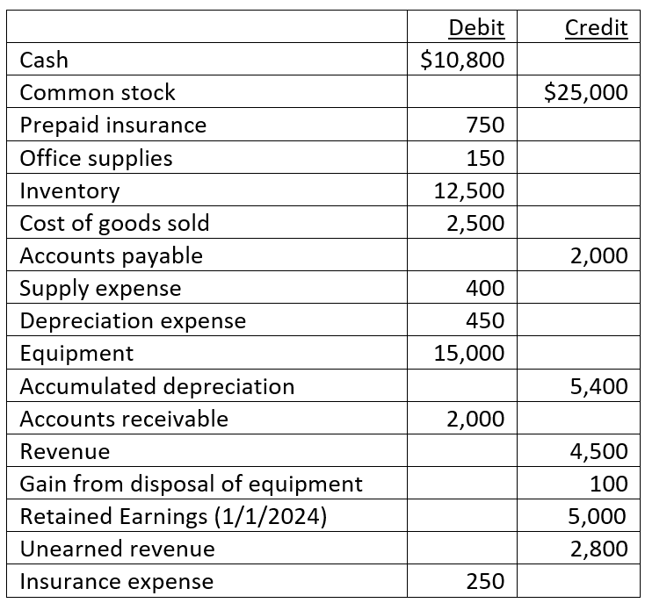
In-class problem (Handout)
Pearl Street Bikes provides the following year-end account balances on December 31, 2024:
Other info:
• On December 31, 2024, the company declared dividends of $50, but did not pay them (This is not included in above accounts).
• The company is subject to a 30% income tax rate. If taxes are owed, the company will pay them in March 2025.
• The unearned revenue is related to goods to be delivered in June 2025.
Prepare a balance sheet for the current year.

Slide 17
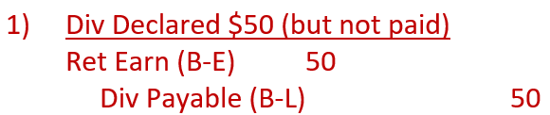
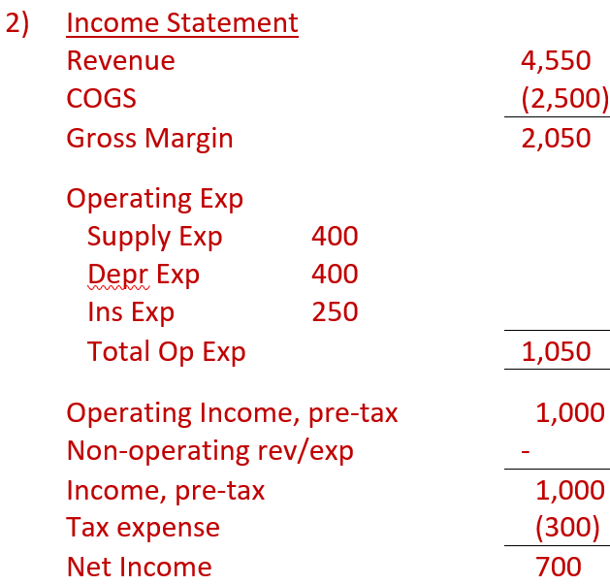
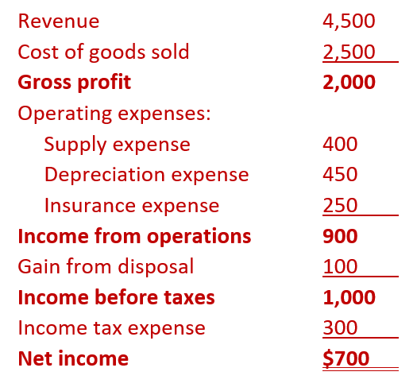
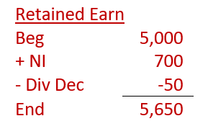
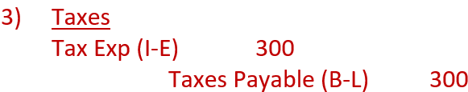
In-class problem (Handout)

Slide 18
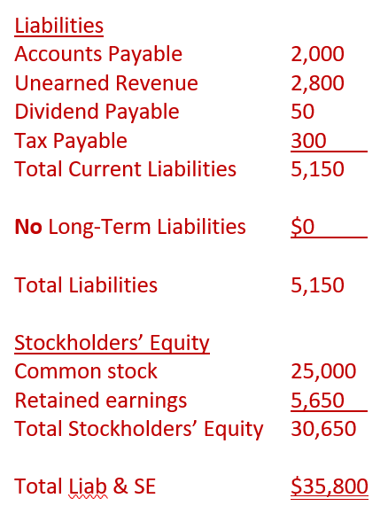
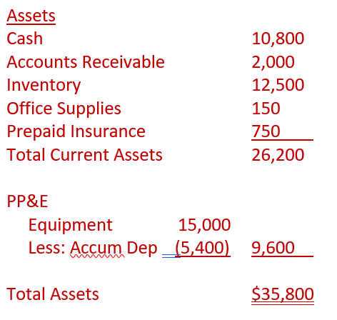
In-class problem (Handout)

Slide 19

Some Takeaways
Classified balance sheet shows current assets and liabilities separately
If there is a par value, APIC reports the amount received in excess.
Dividends declared reduce retained earnings (even if not yet paid in cash)

Slide 20

Bonus Problem?
Discontinued Operations

